Slide 1
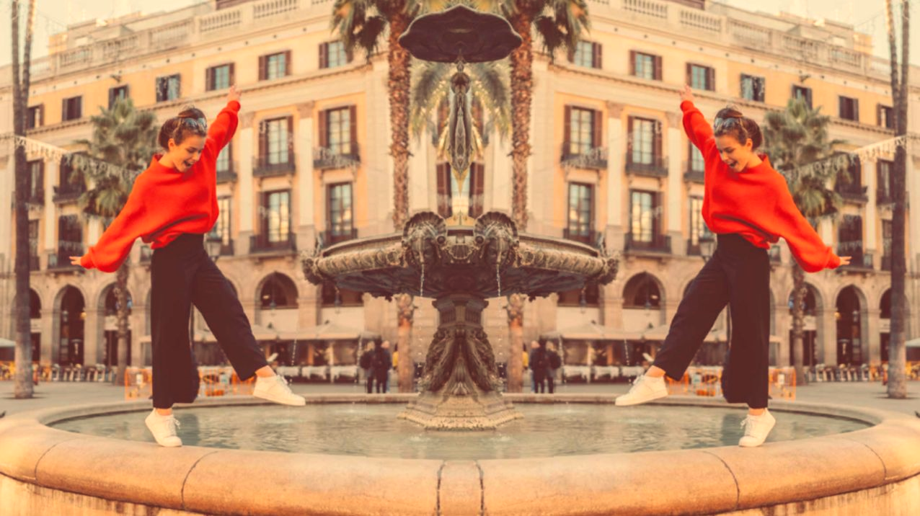
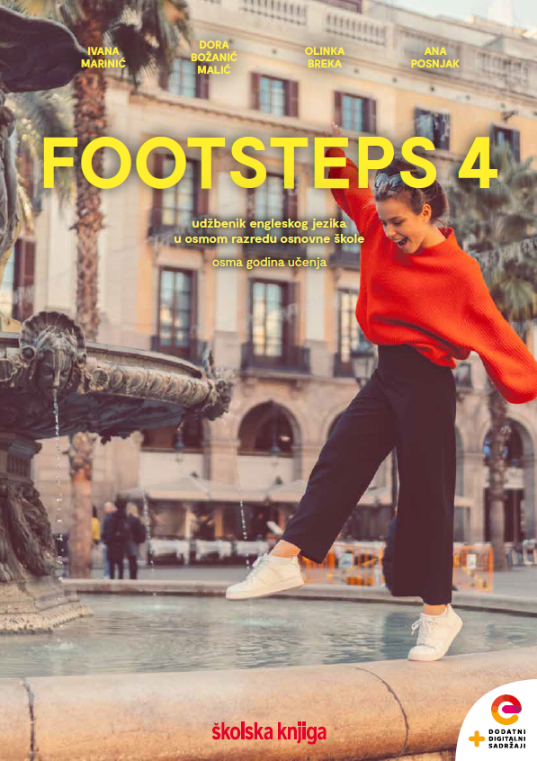

UNIT 7; Choices
Self-check 7

Slide 2
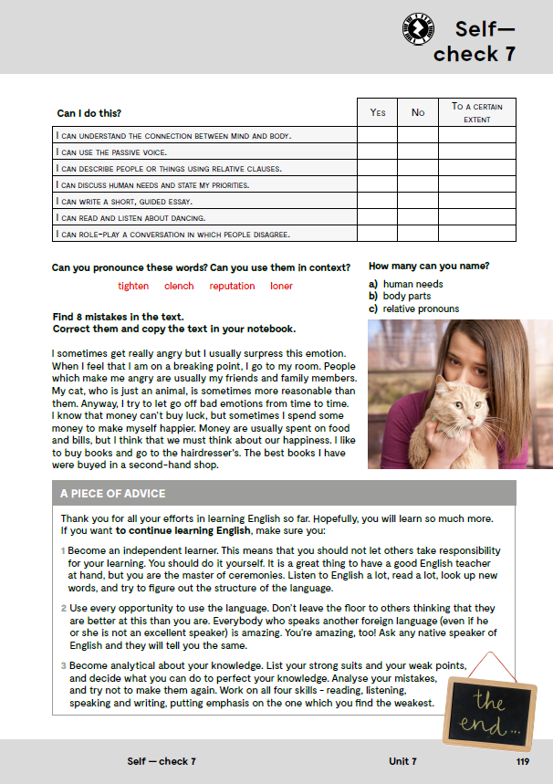
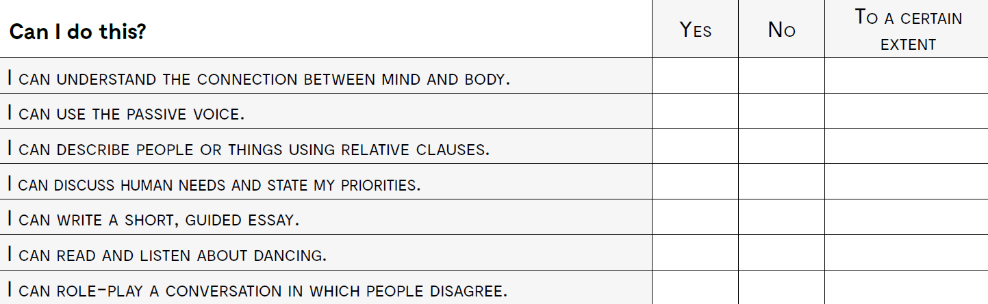
razumjeti vezu između uma i tijela
koristiti Passive voice
opisati ljude i stvari koristeći odnosne zamjenice
razgovarati o ljudskim potrebama i prioritetima
napisati kratki vođeni sastavak
čitati i slušati o plesanju
odglumiti razgovor između ljudi koji se oko određene teme ne slažu

Slide 3
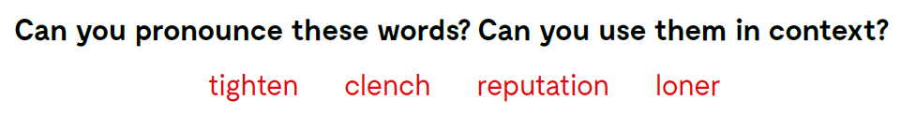
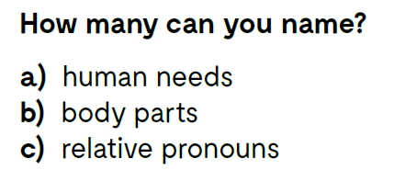

Slide 4
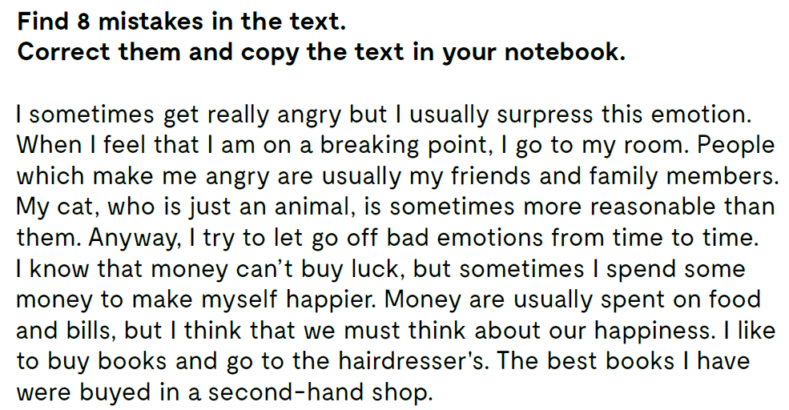
I sometimes get really angry, but I usually suppress this emotion.
When I feel that I am at a breaking point, I go to my room.
People who make me angry are usually my friends and family members.
My cat, that is just an animal, is sometimes more reasonable than them.
Anyway, I try to let go of bad emotions from time to time.
I know that money can’t buy happiness, but sometimes I spend some money to make myself happier.
Money is usually spent on food and bills, but I think that we must think about our happiness. I like to buy books and go to the hairdresser.
The best books I have were bought in a second-hand shop.

Slide 5
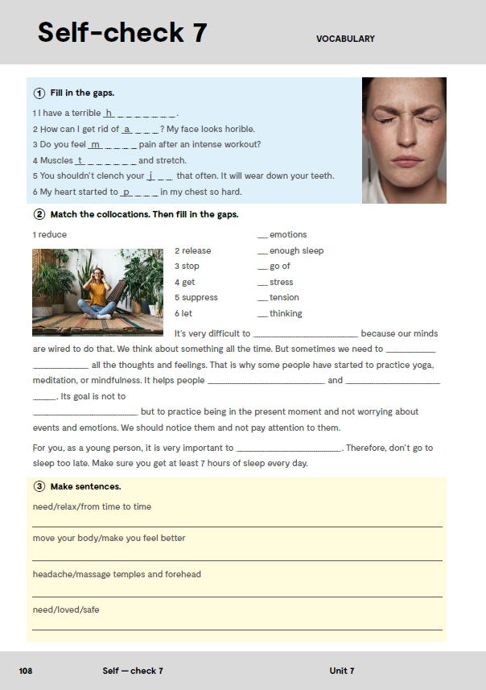
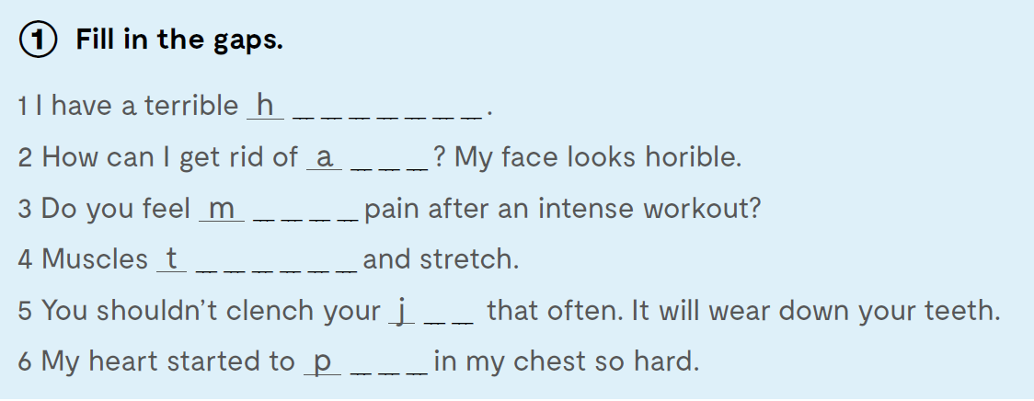
e a d a c h e
c n e
u s c le
e n s i o n
a w
ound

Slide 6
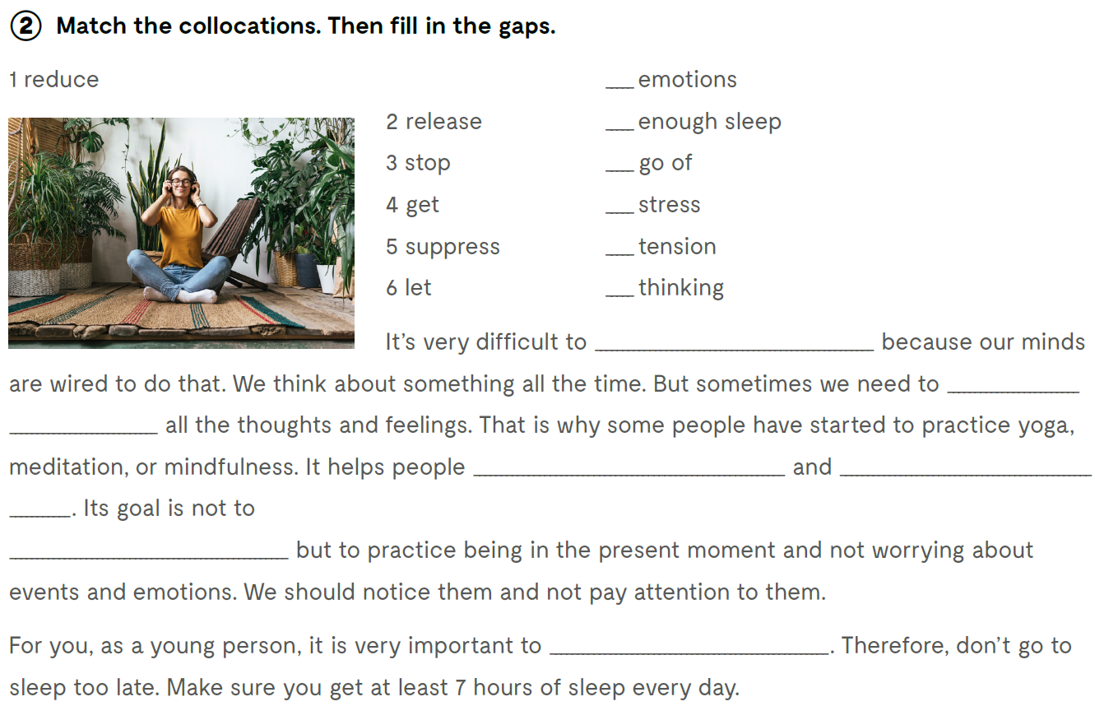
5
4
6
2
1
3
stop thinking
let go of
Let’s practise:
https://www.bookwidgets.com/play/FCBCMFF
reduce tension
release stress
suppress emotions
get enough sleep

Slide 7
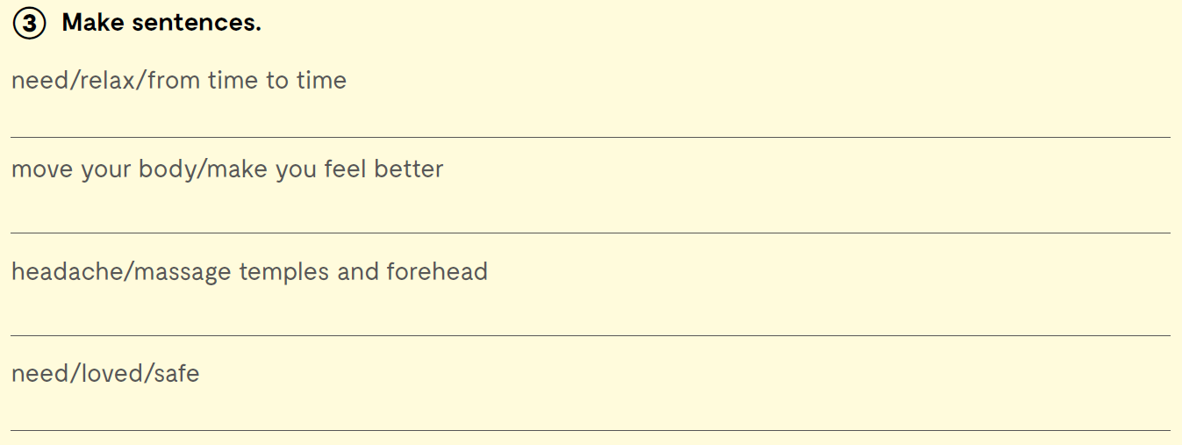
Everybody needs to relax from time to time.
Moving your body will make you feel better.
If you have a headache, you should try massaging temples and forehead.
Everybody needs to feel loved to feel safe.

Slide 8
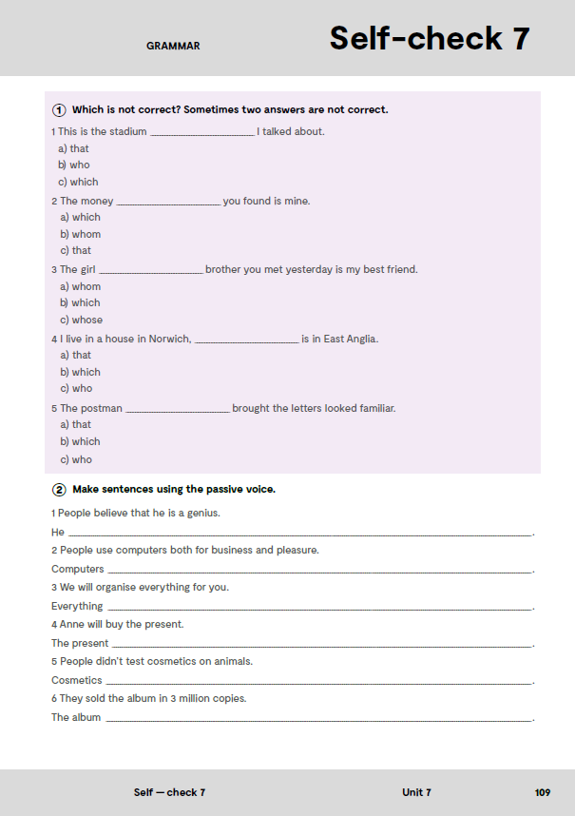
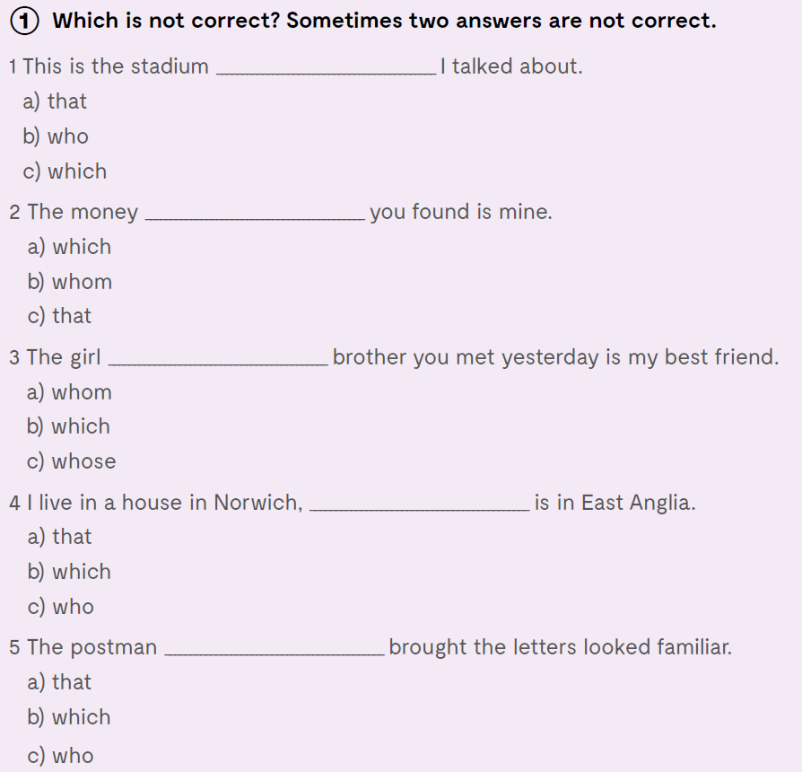

On the next page, page 109.

Slide 9
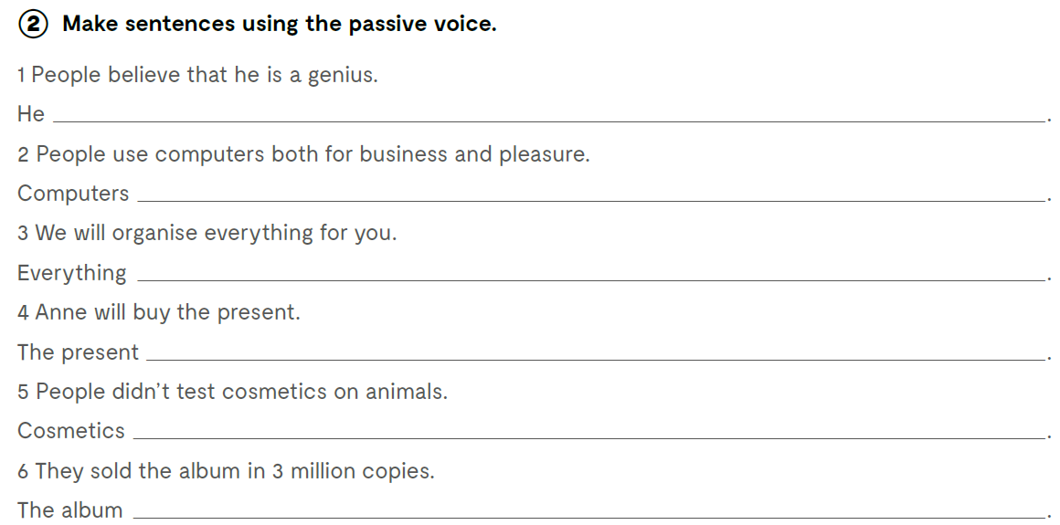
is believed to be a genius
are used both for business and pleasure
will be organized for you
will be bought by Anne
weren’t tested on animals
was sold in 3 million copies

Slide 10
